Slide 1
Unit 9:
Software Evolution

Slide 2
After a system has been deployed, it inevitably has to change if it is to remain useful.
Business changes and changes to user expectations generate new requirements for the existing software.
Parts of the software may have to be modified to correct errors that are found in operation, to adapt it for changes to its hardware and software platform, and to improve its performance or other non-functional characteristics.
Software evolution is important because organizations have invested large amounts of money in their software and are now completely dependent on these systems.
Software evolution may be triggered by changing business requirements, by reports of software defects, or by changes to other systems in a software system’s environment.

Slide 3

Evolution and servicing

Slide 4
Rajlich and Bennett (2000) proposed an alternative view of the software evolution life cycle.
In this model, they distinguish between evolution and servicing.
Evolution is the phase in which significant changes to the software architecture and functionality may be made.
During servicing, the only changes that are made are relatively small, essential changes.
At that stage, the software moves from evolution to servicing. During the servicing phase, the software is still useful and used but only small tactical changes are made to it. During this stage, the company is usually considering how the software can be replaced.
In the final stage, phase-out, the software may still be used but no further changes are being implemented. Users have to work around any problems that they discover.

Slide 5
Evolution processes
Software evolution processes vary depending on the type of software being maintained, the development processes used in an organization and the skills of the people involved.
In some organizations, evolution may be an informal process where change requests mostly come from conversations between the system users and developers.
In other companies, it is a formalized process with structured documentation produced at each stage in the process.
System change proposals are the driver for system evolution in all organizations.
Change proposals may come from existing requirements that have not been implemented in the released system, requests for new requirements, bug reports from system stakeholders, and new ideas for software improvement from the system development team.

Slide 6
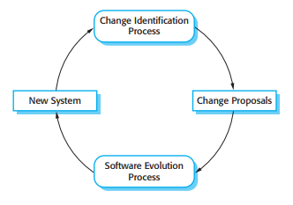
Evolution processes
Change proposals should be linked to the components of the system that have to be modified to implement these proposals. This allows the cost and the impact of the change to be assessed. This is part of the general process of change management, which also should ensure that the correct versions of components are included in each system release.

Slide 7
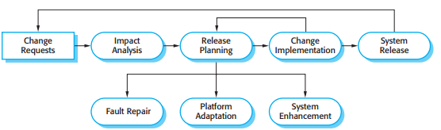
Evolution processes
The software evolution process

Slide 8
Evolution processes
The process includes the fundamental activities of change analysis, release planning, system implementation, and releasing a system to customers.
The cost and impact of these changes are assessed to see how much of the system is affected by the change and how much it might cost to implement the change.
If the proposed changes are accepted, a new release of the system is planned. During release planning, all proposed changes (fault repair, adaptation, and new functionality) are considered.
A decision is then made on which changes to implement in the next version of the system.
The changes are implemented and validated, and a new version of the system is released. The process then iterates with a new set of changes proposed for the next release

Slide 9

Evolution processes
Change implementation
Change implementation as an iteration of the development process, where the revisions to the system are designed, implemented, and tested.

Slide 10
Evolution processes
Change implementation
Ideally, the change implementation stage of the software evolution process should modify the system specification, design, and implementation to reflect the changes to the system.
New requirements that reflect the system changes are proposed, analyzed, and validated.
System components are redesigned and implemented and the system is retested.
If appropriate, prototyping of the proposed changes may be carried out as part of the change analysis process

Slide 11
Evolution processes
Change Request
Change requests sometimes relate to system problems that have to be tackled urgently.
These urgent changes can arise for three reasons:
If a serious system fault occurs that has to be repaired to allow normal operation to continue.
If changes to the systems operating environment have unexpected effects that disrupt normal operation.
If there are unanticipated changes to the business running the system, such as the emergence of new competitors or the introduction of new legislation that affects the system.

Slide 12

Evolution processes
The Emergency Repair Process
Rather than modify the requirements and design, you make an emergency fix to the program to solve the immediate problem.
Although you may intend to document the change in the requirements and design, additional emergency fixes to the software may then be needed. These take priority over documentation
Emergency system repairs usually have to be completed as quickly as possible.
When emergency code repairs are made the change request should remain outstanding after the code faults have been fixed. It can then be re-implemented more carefully after further analysis. Of course, the code of the repair may be reused.

Slide 13
Evolution processes
The Emergency Repair Process
Problems may arise in situations in which there is a handover from a development team to a separate team responsible for evolution.
There are two potentially problematic situations:
Where the development team has used an agile approach but the evolution team is unfamiliar with agile methods and prefers a plan-based approach. The evolution team may expect detailed documentation to support evolution and this is rarely produced in agile processes. There may be no definitive statement of the system requirements that can be modified as changes are made to the system.
Where a plan-based approach has been used for development but the evolution team prefers to use agile methods. In this case, the evolution team may have to start from scratch developing automated tests and the code in the system may not have been refactored and simplified as is expected in agile development. In this case, some reengineering may be required to improve the code before it can be used in an agile development process.

Slide 14
Evolution processes
During the evolution process, the requirements are analyzed in detail and implications of the changes emerge that were not apparent in the earlier change analysis process. This means that the proposed changes may be modified and further customer discussions may be required before they are implemented.

Slide 15
Program Evolution Dynamics
Program evolution dynamics is the study of system change.
‘Lehman’s laws’
concerning system change
these laws are likely to be true for all types of large organizational software systems (what they call E-type systems)

Slide 16
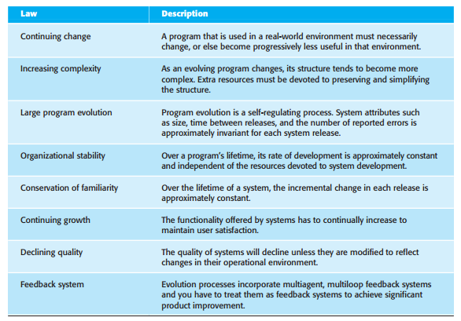
Program Evolution Dynamics
‘Lehman’s laws’

Slide 17
Program Evolution Dynamics
‘Lehman’s laws’
The first law states that system maintenance is an inevitable process. As the system’s environment changes, new requirements emerge and the system must be modified. When the modified system is reintroduced to the environment, this promotes more environmental changes, so the evolution process starts again.
The second law states that, as a system is changed, its structure is degraded. The only way to avoid this happening is to invest in preventative maintenance. You spend time improving the software structure without adding to its functionality. Obviously, this means additional costs, over and above those of implementing required system changes.

Slide 18
Program Evolution Dynamics
‘Lehman’s laws’
The third law is, perhaps, the most interesting and the most contentious of Lehman’s laws.
It suggests that large systems have a dynamic of their own that is established at an early stage in the development process. This determines the gross trends of the system maintenance process and limits the number of possible system changes.
Lehman and Belady suggest that this law is a consequence of structural factors that influence and constrain system change, and organizational factors that affect the evolution process.

Slide 19
Program Evolution Dynamics
‘Lehman’s laws’
The structural factors that affect the third law come from the complexity of large systems. As you change and extend a program, its structure tends to degrade.
This degradation, if unchecked, makes it more and more difficult to make further changes to the program.
Making small changes reduces the extent of structural degradation and so lessens the risks of causing serious system dependability problems.
If you try and make large changes, there is a high probability that these will introduce new faults. These then inhibit further program changes

Slide 20
Program Evolution Dynamics
‘Lehman’s laws’
Lehman’s fourth law suggests that most large programming projects work in a ‘saturated’ state.
That is, a change to resources or staffing has imperceptible effects on the long-term evolution of the system. This is consistent with the third law, which suggests that program evolution is largely independent of management decisions. This law confirms that large software development teams are often unproductive because communication overheads dominate the work of the team.

Slide 21
Program Evolution Dynamics
‘Lehman’s laws’
Lehman’s fifth law is concerned with the change increments in each system release.
Adding new functionality to a system inevitably introduces new system faults. The more functionality added in each release, the more faults there will be.
This law suggests that you should not budget for large functionality increments in each release without taking into account the need for fault repair

Slide 22
Program Evolution Dynamics
‘Lehman’s laws’
The sixth and seventh laws are similar and essentially say that users of software will become increasingly unhappy with it unless it is maintained and new functionality is added to it.
The final law reflects the most recent work on feedback processes, although it is not yet clear how this can be applied in practical software development

Slide 23
Software Maintenance
Software maintenance is the general process of changing a system after it has been delivered.
The term is usually applied to custom software in which separate development groups are involved before and after delivery.
The changes made to the software may be simple changes to correct coding errors, more extensive changes to correct design errors, or significant enhancements to correct specification errors or accommodate new requirements.
Changes are implemented by modifying existing system components and, where necessary, by adding new components to the system.

Slide 24
Software Maintenance
There are three different types of software maintenance:
1. Fault repairs
2. Environmental adaptation
3. Functionality addition

Slide 25
Software Maintenance
There are three different types of software maintenance:
Fault repairs
Coding errors are usually relatively cheap to correct; design errors are more expensive as they may involve rewriting several program components.
Requirements errors are the most expensive to repair because of the extensive system redesign which may be necessary.

Slide 26
Software Maintenance
There are three different types of software maintenance:
2. Environmental adaptation
This type of maintenance is required when some aspect of the system’s environment such as the hardware, the platform operating system, or other support software changes.
The application system must be modified to adapt it to cope with these environmental changes.

Slide 27
Software Maintenance
There are three different types of software maintenance:
3. Functionality addition
This type of maintenance is necessary when the system requirements change in response to organizational or business change.
The scale of the changes required to the software is often much greater than for the other types of maintenance

Slide 28
Software Maintenance
These types of maintenance are generally recognized but different people sometimes give them different names.
Corrective maintenance is universally used to refer to maintenance for fault repair.
Adaptive maintenance sometimes means adapting to a new environment and sometimes means adapting the software to new requirements.
Perfective maintenance sometimes means perfecting the software by implementing new requirements; in other cases it means maintaining the functionality of the system but improving its structure and its performance.

Slide 29
Software Maintenance
The overall lifetime costs may decrease as more effort is expended during system development to produce a maintainable system.
Because of the potential reduction in costs of understanding, analysis, and testing, there is a significant multiplier effect when the system is developed for maintainability.

Slide 30
Software Maintenance
It is usually more expensive to add functionality after a system is in operation than it is to implement the same functionality during development.
The reasons for this are:
Team stability
Poor development practice
Staff skills
Program age and structure

Slide 31
Software Maintenance
Team stability
After a system has been delivered, it is normal for the development team to be broken up and for people to work on new projects.
The new team or the individuals responsible for system maintenance do not understand the system or the background to system design decisions.
They need to spend time understanding the existing system before implementing changes to it.

Slide 32
Software Maintenance
2. Poor development practice
The contract to maintain a system is usually separate from the system development contract. The maintenance contract may be given to a different company rather than the original system developer. This factor, along with the lack of team stability, means that there is no incentive for a development team to write maintainable software. If a development team can cut corners to save effort during development it is worthwhile for them to do so, even if this means that the software is more difficult to change in the future.

Slide 33
Software Maintenance
3. Staff skills
Maintenance staff are often relatively inexperienced and unfamiliar with the application domain.
Maintenance has a poor image among software engineers.
It is seen as a less-skilled process than system development and is often allocated to the most junior staff.
Furthermore, old systems may be written in obsolete programming languages.
The maintenance staff may not have much experience of development in these languages and must learn these languages to maintain the system.

Slide 34
Software Maintenance
4. Program age and structure
As changes are made to programs, their structure tends to degrade.
Consequently, as programs age, they become harder to understand and change.
Some systems have been developed without modern software engineering techniques.
They may never have been well structured and were perhaps optimized for efficiency rather than understandability.
System documentation may be lost or inconsistent.
Old systems may not have been subject to stringent configuration management so time is often wasted finding the right versions of system components to change.

Slide 35
Software Maintenance
Maintenance prediction
Software reengineering
Preventative maintenance by refactoring

Slide 36
Software Maintenance
Maintenance prediction
You should therefore try to predict what system changes might be proposed and what parts of the system are likely to be the most difficult to maintain.
You should also try to estimate the overall maintenance costs for a system in a given time period.

Slide 37
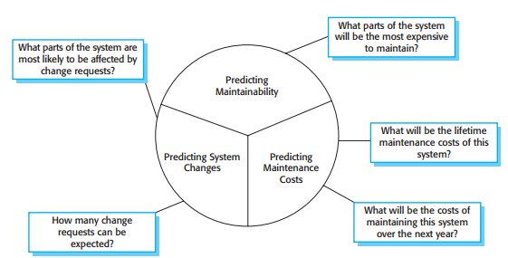
Software Maintenance
Maintenance prediction

Slide 38
Software Maintenance
Maintenance prediction
Predicting the number of change requests for a system requires an understanding of the relationship between the system and its external environment.

Slide 39
Software Maintenance
Maintenance prediction
To evaluate the relationships between a system and its environment, you should assess:
The number and complexity of system interfaces: The larger the number of interfaces and the more complex these interfaces, the more likely it is that interface changes will be required as new requirements are proposed.
The number of inherently volatile system requirements: Requirements that reflect organizational policies and procedures are likely to be more volatile than requirements that are based on stable domain characteristics.
The business processes in which the system is used: As business processes evolve, they generate system change requests. The more business processes that use a system, the more the demands for system change.

Slide 40
Software Maintenance
Maintenance prediction
After a system has been put into service, you may be able to use process data to help predict maintainability.
Examples of process metrics that can be used for assessing maintainability are as follows:
Number of requests for corrective maintenance: An increase in the number of bug and failure reports may indicate that more errors are being introduced into the program than are being repaired during the maintenance process. This may indicate a decline in maintainability.
Average time required for impact analysis: This reflects the number of program components that are affected by the change request. If this time increases, it implies more and more components are affected and maintainability is decreasing.

Slide 41
Software Maintenance
Maintenance prediction
Average time taken to implement a change request: This is the amount of time that you need to modify the system and its documentation, after you have assessed which components are affected. An increase in the time needed to implement a change may indicate a decline in maintainability.
Number of outstanding change requests: An increase in this number over time may imply a decline in maintainability.

Slide 42
Software Maintenance
Software Reengineering
The programs may have been optimized for performance or space utilization at the expense of understandability, or, over time, the initial program structure may have been corrupted by a series of changes.
To make legacy software systems easier to maintain, you can reengineer these systems to improve their structure and understandability.

Slide 43
Software Maintenance
Software Reengineering
Reengineering may involve redocumenting the system, refactoring the system architecture, translating programs to a modern programming language, and modifying and updating the structure and values of the system’s data.
The functionality of the software is not changed and, normally, you should try to avoid making major changes to the system architecture.
Reengineering takes place after a system has been maintained for some time and maintenance costs are increasing. You use automated tools to process and reengineer a legacy system to create a new system that is more maintainable.

Slide 44
Software Maintenance
Software Reengineering
There are two important benefits from reengineering rather than replacement:
Reduced risk There is a high risk in redeveloping business-critical software. Errors may be made in the system specification or there may be development problems. Delays in introducing the new software may mean that business is lost and extra costs are incurred.
Reduced cost: The cost of reengineering may be significantly less than the cost of developing new software.

Slide 45
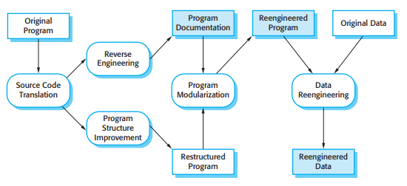
Software Maintenance
Software Reengineering
The reengineering process

Slide 46
Software Maintenance
Software Reengineering
Source code translation: Using a translation tool, the program is converted from an old programming language to a more modern version of the same language or to a different language.
Reverse engineering: The program is analyzed and information extracted from it. This helps to document its organization and functionality. Again, this process is usually completely automated.
Program structure improvement: The control structure of the program is analyzed and modified to make it easier to read and understand. This can be partially automated but some manual intervention is usually required.

Slide 47
Software Maintenance
Software Reengineering
Program modularization: Related parts of the program are grouped together and, where appropriate, redundancy is removed. In some cases, this stage may involve architectural refactoring (e.g., a system that uses several different data stores may be refactored to use a single repository). This is a manual process.
Data reengineering The data processed by the program is changed to reflect program changes. This may mean redefining database schemas and converting existing databases to the new structure. You should usually also clean up the data. This involves finding and correcting mistakes, removing duplicate records, etc. Tools are available to support data reengineering.

Slide 48
Software Maintenance
Preventative maintenance by refactoring
Refactoring is a continuous process of improvement throughout the development and evolution process. It is intended to avoid the structure and code degradation that increases the costs and difficulties of maintaining a system.

Slide 49
Software Maintenance
Preventative maintenance by refactoring
Fowler et al. (1999) suggest that there are stereotypical situations (he calls them ‘bad smells’) in which the code of a program can be improved.
Examples of bad smells that can be improved through refactoring include:
Duplicate code
Long methods
Switch (case) statements
Data clumping
Speculative generality

Slide 50
Software Maintenance
Preventative maintenance by refactoring
Duplicate code: The same of very similar code may be included at different places in a program. This can be removed and implemented as a single method or function that is called as required.
Long methods: If a method is too long, it should be redesigned as a number of shorter methods.
Switch (case) statements: These often involve duplication, where the switch depends on the type of some value. The switch statements may be scattered around a program. In object-oriented languages, you can often use polymorphism to achieve the same thing.

Slide 51
Software Maintenance
Preventative maintenance by refactoring
Data clumping: Data clumps occur when the same group of data items (fields in classes, parameters in methods) reoccur in several places in a program. These can often be replaced with an object encapsulating all of the data.
Speculative generality: This occurs when developers include generality in a program in case it is required in future. This can often simply be removed.

Slide 52
Software Maintenance
Legacy system management
Most organizations usually have a portfolio of legacy systems that they use, with a limited budget for maintaining and upgrading these systems.
They have to decide how to get the best return on their investment.
This involves making a realistic assessment of their legacy systems and then deciding on the most appropriate strategy for evolving these systems

Slide 53
Software Maintenance
Legacy system management
There are four strategic options:
Scrap the system completely
Leave the system unchanged and continue with regular maintenance
Reengineer the system to improve its maintainability.
Replace all or part of the system with a new system

Slide 54
Software Maintenance
Legacy system management
Scrap the system completely: This option should be chosen when the system is not making an effective contribution to business processes. This commonly occurs when business processes have changed since the system was installed and are no longer reliant on the legacy system.
Leave the system unchanged and continue with regular maintenance: This option should be chosen when the system is still required but is fairly stable and the system users make relatively few change requests.

Slide 55
Software Maintenance
Legacy system management
Reengineer the system to improve its maintainability: This option should be chosen when the system quality has been degraded by change and where a new change to the system is still being proposed.
Replace all or part of the system with a new system: This option should be chosen when factors, such as new hardware, mean that the old system cannot continue in operation or where off-the-shelf systems would allow the new system to be developed at a reasonable cost.

Slide 56
Software Maintenance
Legacy system management
Reengineer the system to improve its maintainability: This option should be chosen when the system quality has been degraded by change and where a new change to the system is still being proposed.
Replace all or part of the system with a new system: This option should be chosen when factors, such as new hardware, mean that the old system cannot continue in operation or where off-the-shelf systems would allow the new system to be developed at a reasonable cost.

Slide 57
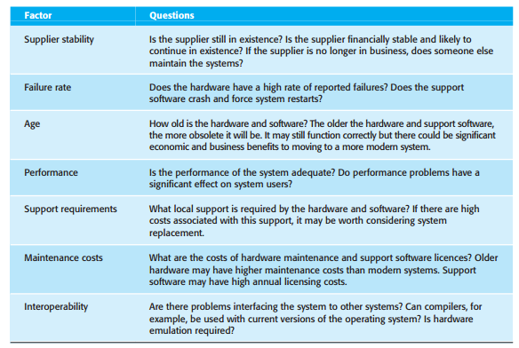
Legacy system management
Notice that these are not all technical characteristics of the environment.

Slide 58
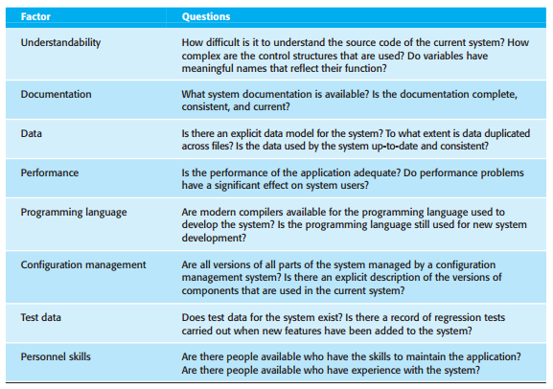
Legacy system management
Factors used in application assessment to access the technical quality of application system.

Slide 59
Software Maintenance
Legacy system management
Data that may be useful in quality assessment are:
The number of system change requests: System changes usually corrupt the system structure and make further changes more difficult. The higher this accumulated value, the lower the quality of the system.
The number of user interfaces: This is an important factor in forms-based systems where each form can be considered as a separate user interface. The more interfaces, the more likely that there will be inconsistencies and redundancies in these interfaces.
The volume of data used by the system: The higher the volume of data (number of files, size of database, etc.), the more likely that it is that there will be data inconsistencies that reduce the system quality.

